Slide 1
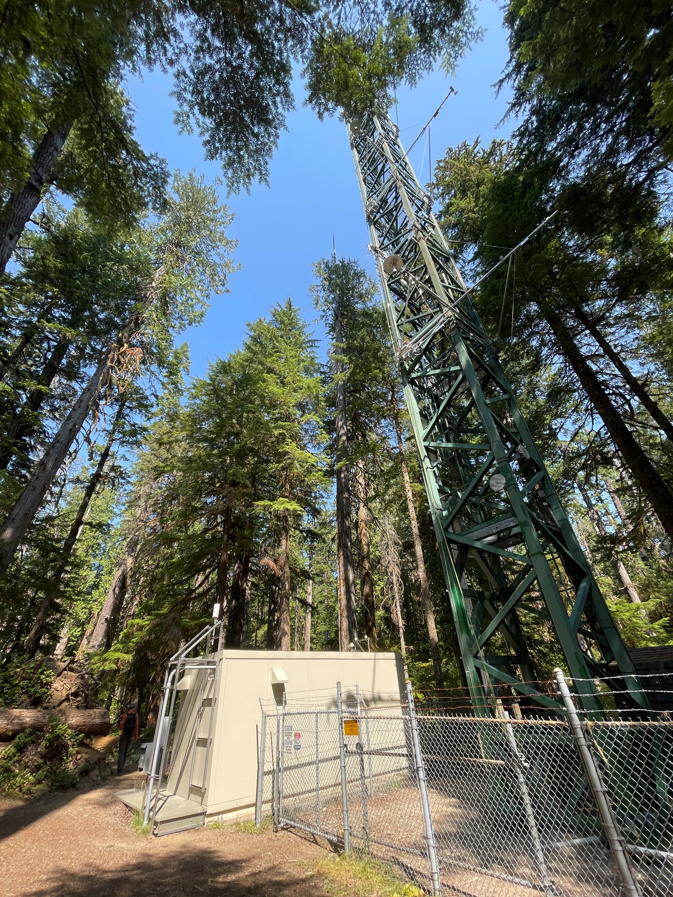


Overstory and understory leaves warm faster than air in evergreen needleleaf forests
Keenan Ganz¹, Christopher J. Still²,
Bharat Rastogi³, L. Monika Moskal¹
1: School of Environmental and Forest Sciences, University of Washington
2: Department of Forest Ecosystems and Society, Oregon State University
3: Department of Geography, University of Colorado

Slide 2
Why is leaf temperature interesting?

Slide 3
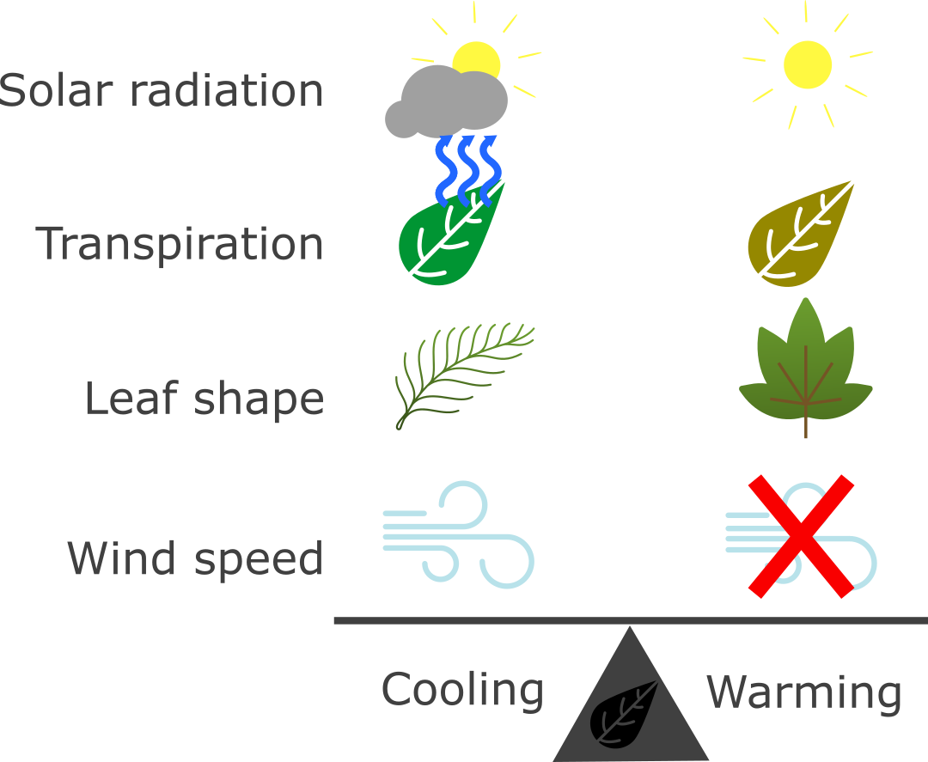
Leaf temperature integrates environmental forcing and plant physiology

Slide 4
Leaf temperature integrates environmental forcing and plant physiology

Slide 5
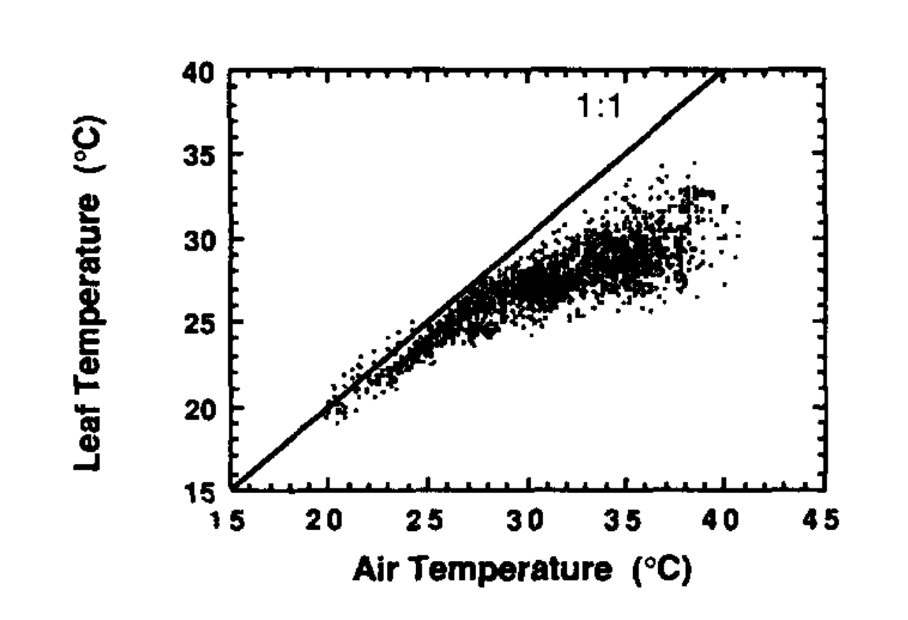
Are plants homeothermic?
If so:
Air-leaf regression slope < 1.
Leaves cooler than air at high air temperature.
Plants could be resilient to thermal stress due to climate change.
Well-watered cotton.
Upchurch and Mahan (1988)

Slide 6
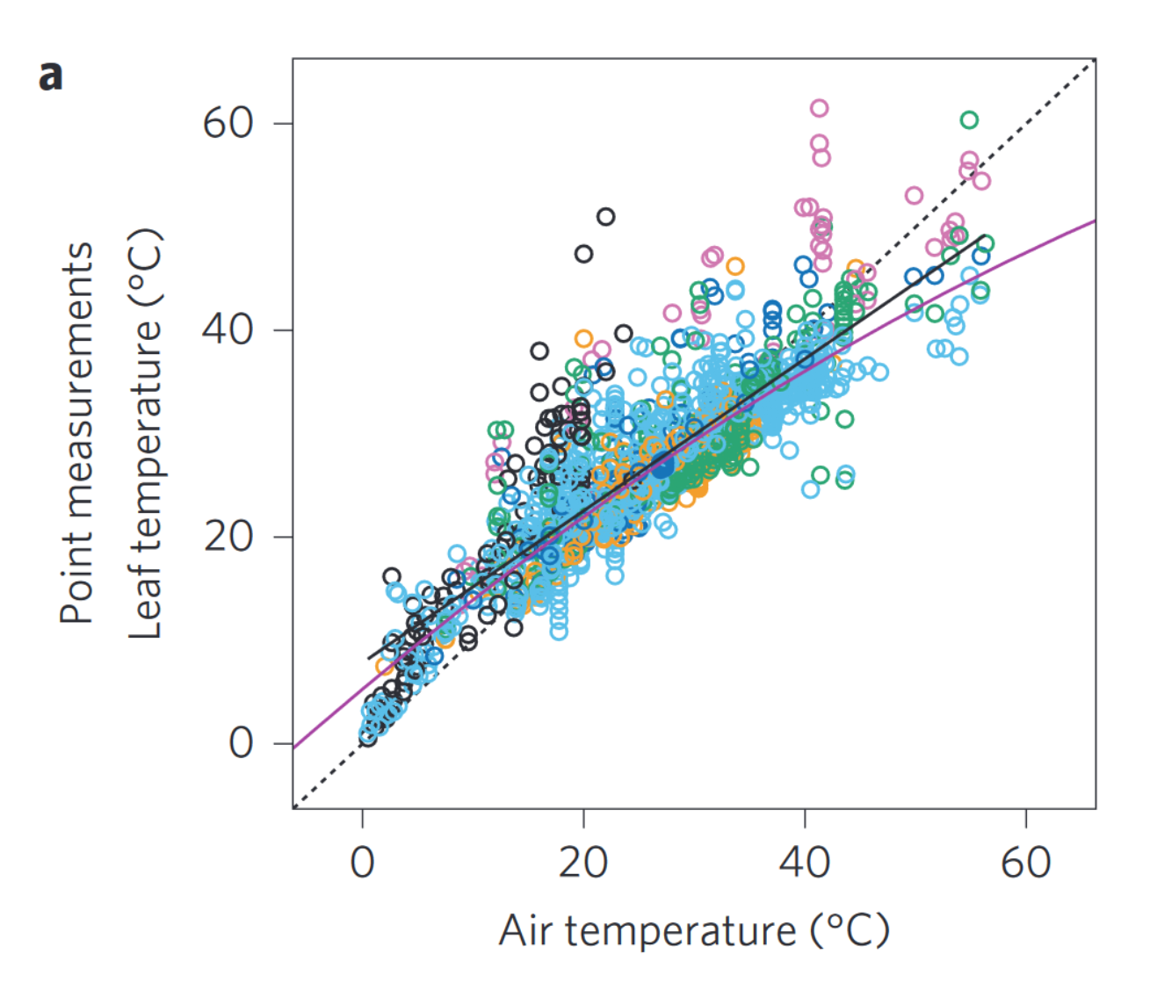
Global leaf trait datasets support limited homeothermy…
Slope = 0.74
Leaf T < Air T during warm periods
Michaletz et al. (2016). Nature Plants.

Slide 7
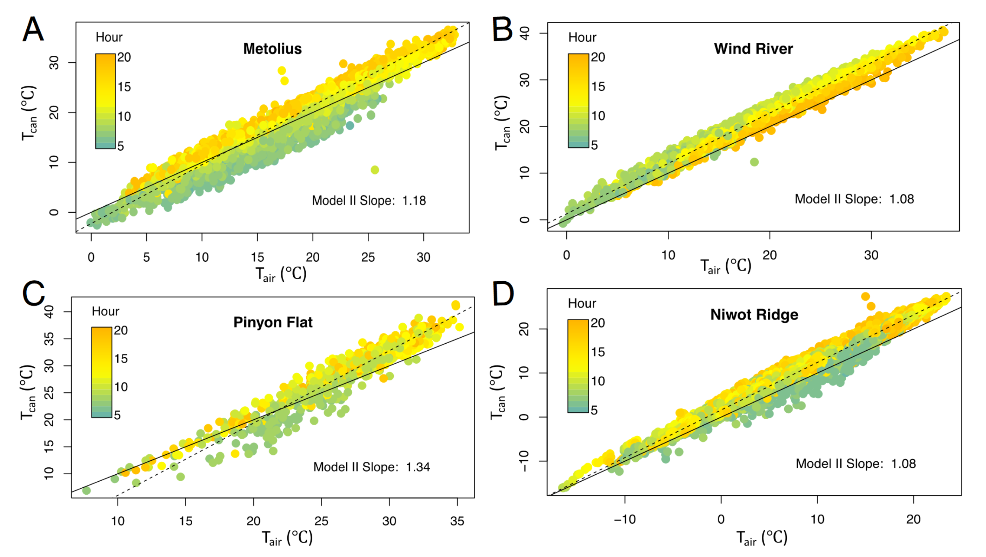
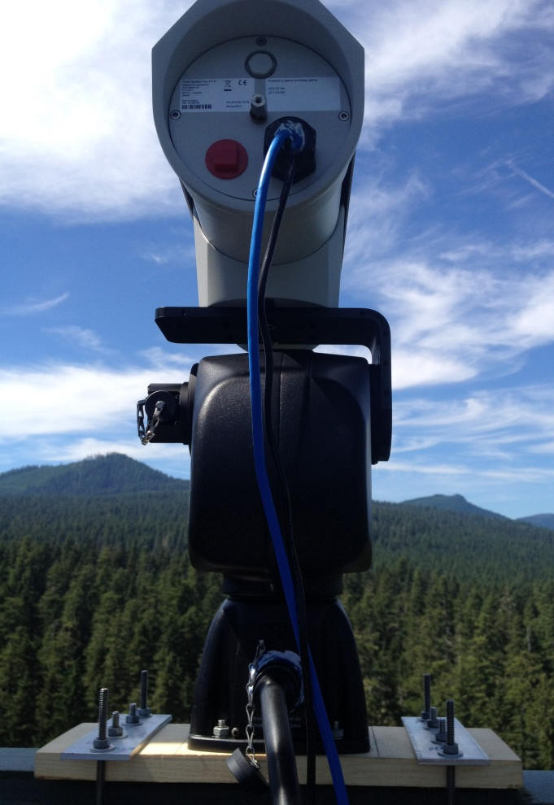
…but limited field observations do not support limited homeothermy.
Still et al. (2022). PNAS.
*Only considers the canopy top!

Slide 8
Does homeothermy occur in some canopy positions, but not others?
What drives leaf temperature – the environment, or plant physiology?

Slide 9
Methods (Abridged)

Slide 10
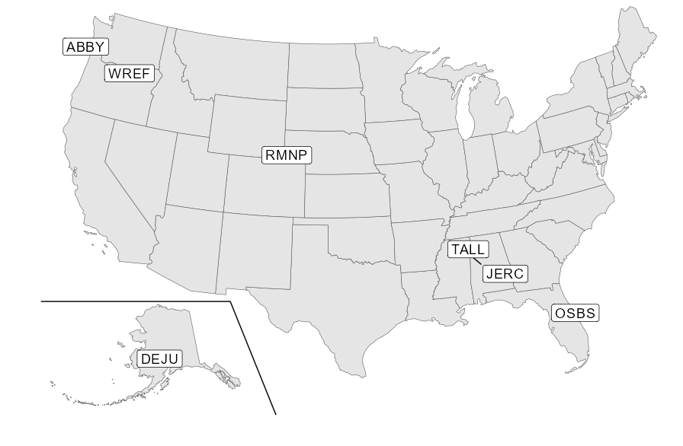
We identified 7 evergreen forests to test the limited homeothermy hypothesis

Slide 11
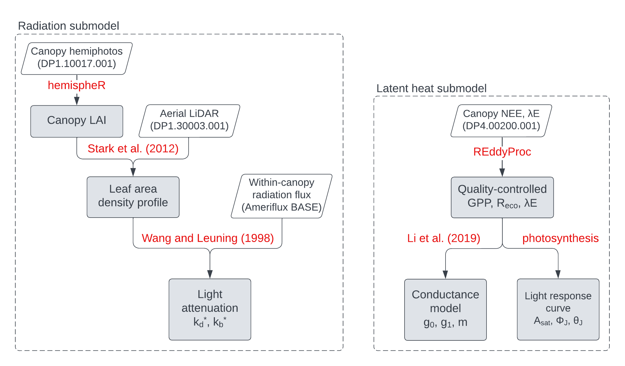
Site data parameterizes a leaf-level energy balance model

Slide 12





We repeated the energy balance model independently across canopy layers
$$R_{n}+H−λE=0$$
$$R_{n}+H−λE=0$$
$$R_{n}+H−λE=0$$
$$R_{n}+H−λE=0$$

Slide 13
Results

Slide 14
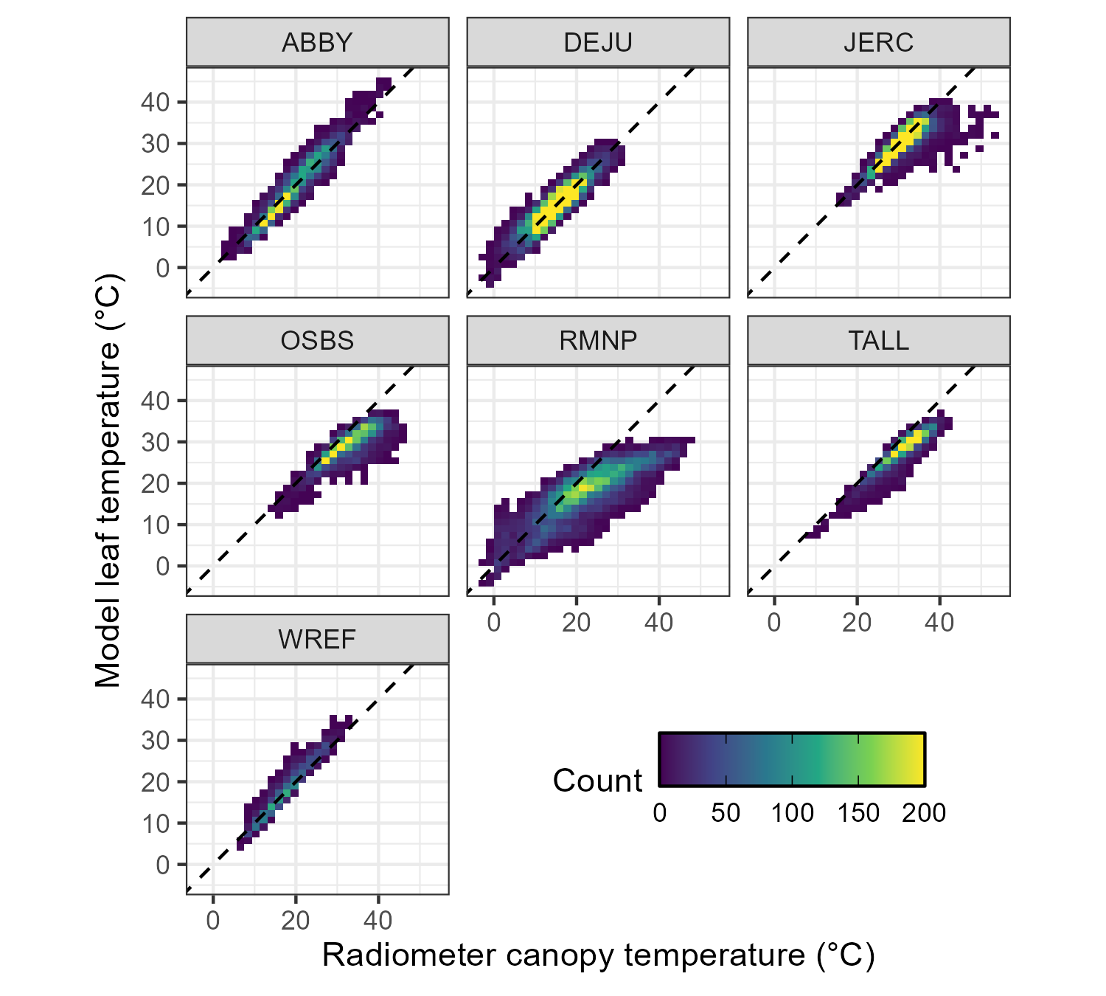
Modeled temperatures were generally cooler than canopy radiometers

Slide 15





LiDAR indicated that radiometers are biased by non-leaf background
WREF
DEJU

Slide 16
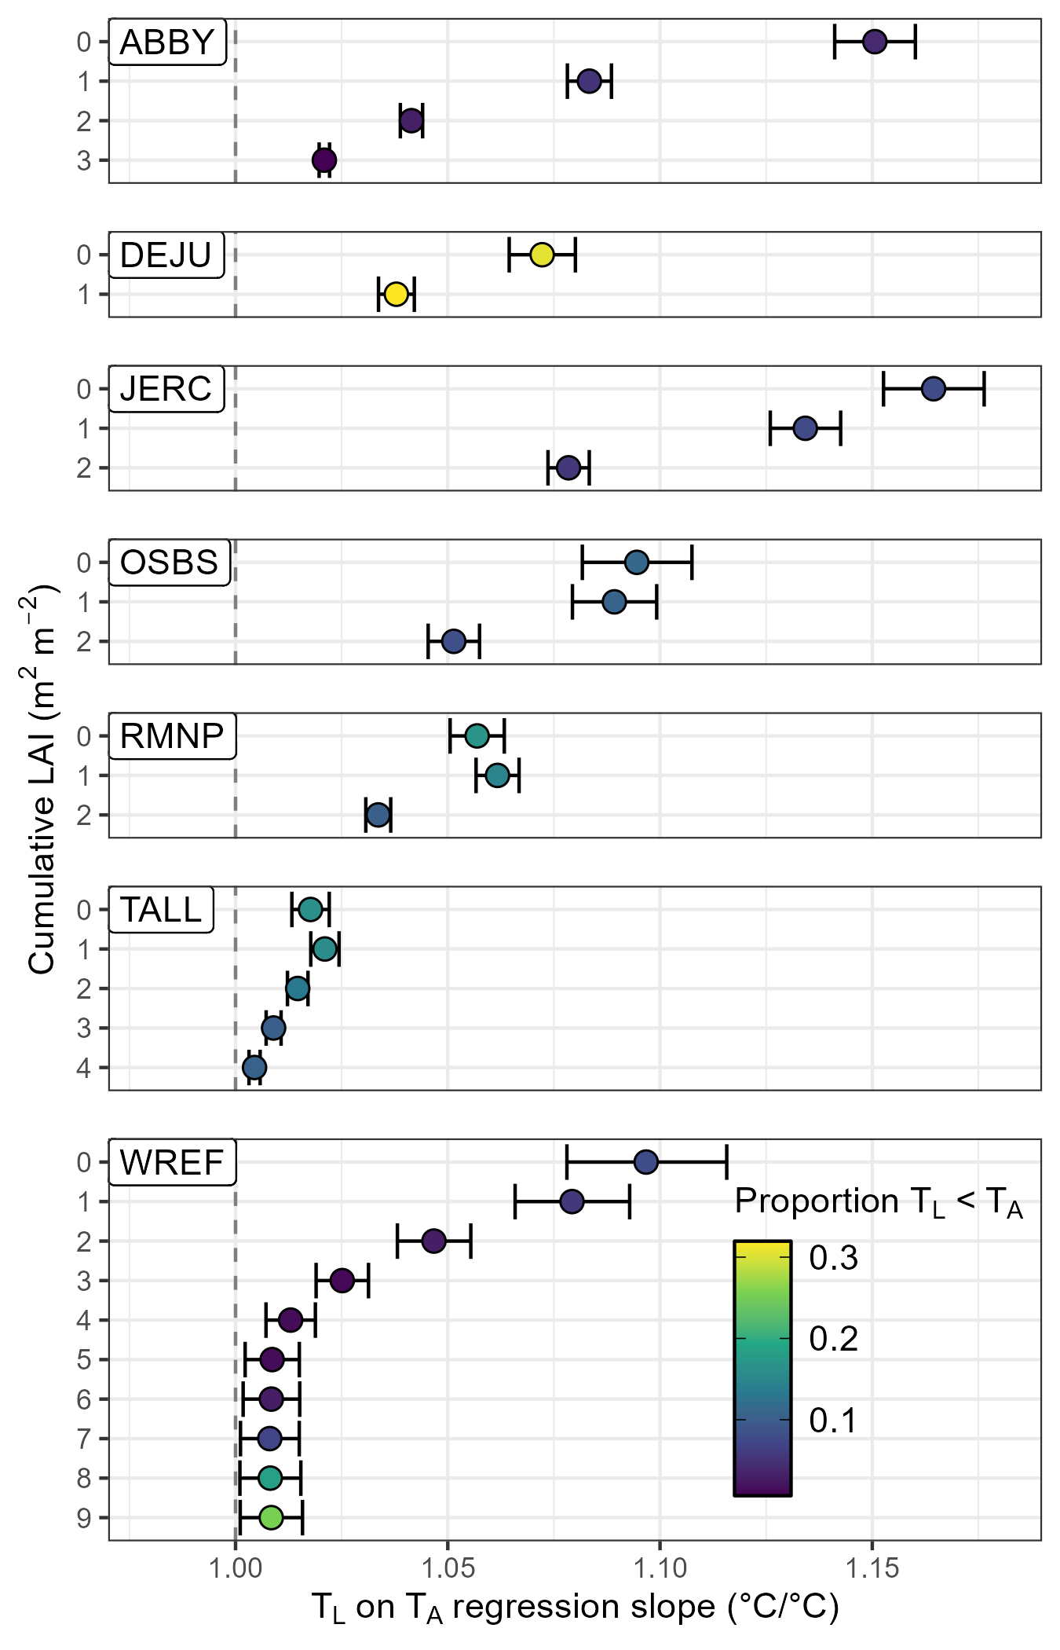
No canopy layers showed evidence of limited homeothermy

Slide 17
No canopy layers showed evidence of limited homeothermy

Slide 18
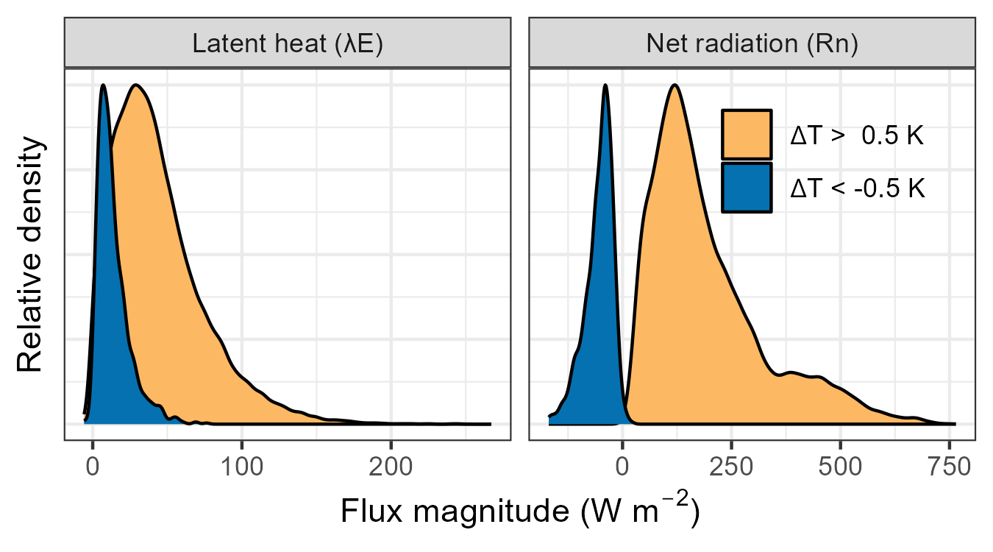
Cooling below air temperature was driven by emitted radiation, not latent heat

Slide 19
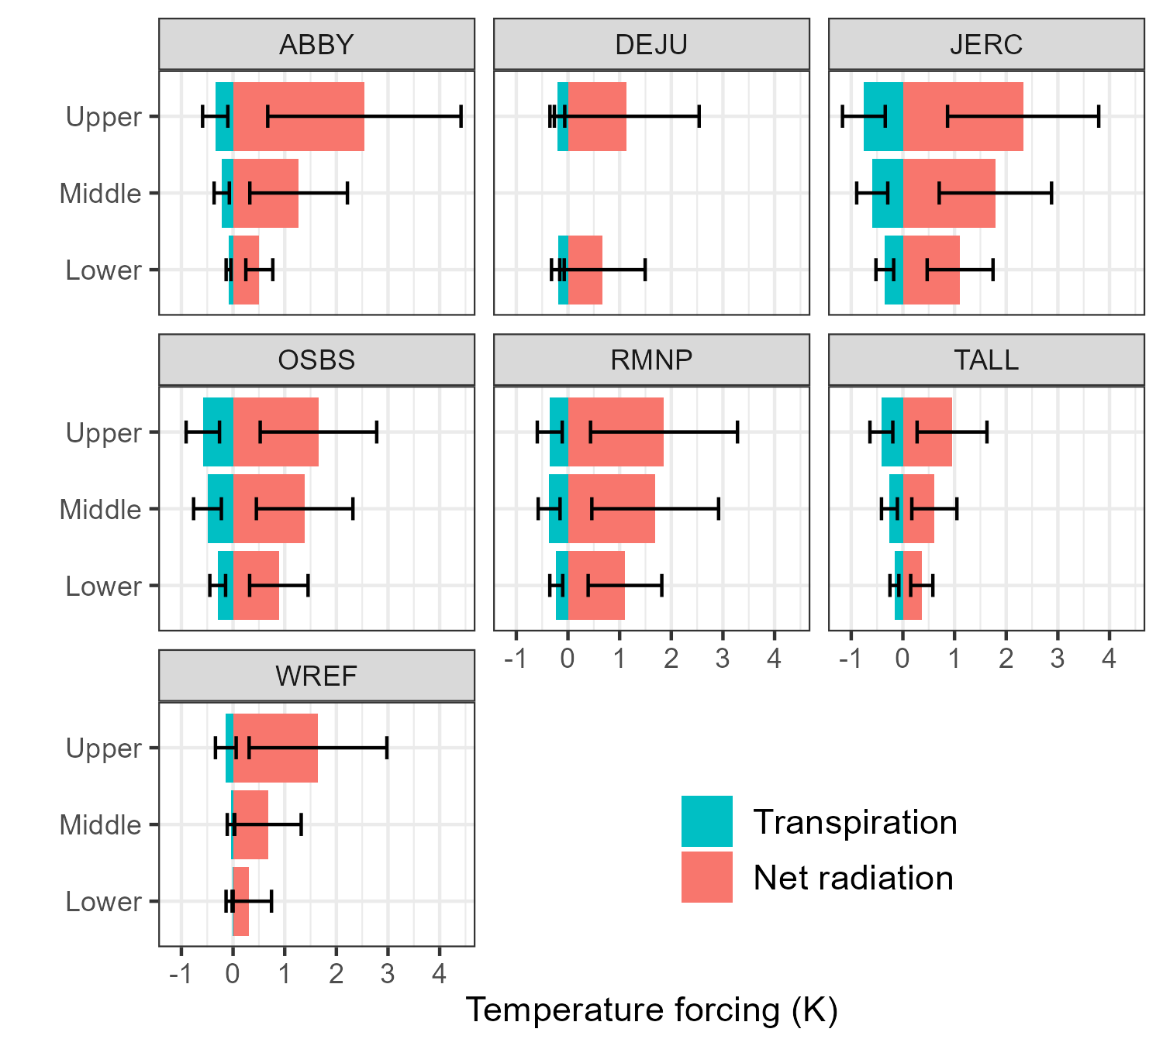
Temperature forcing was dominated by the environment, not transpiration

Slide 20
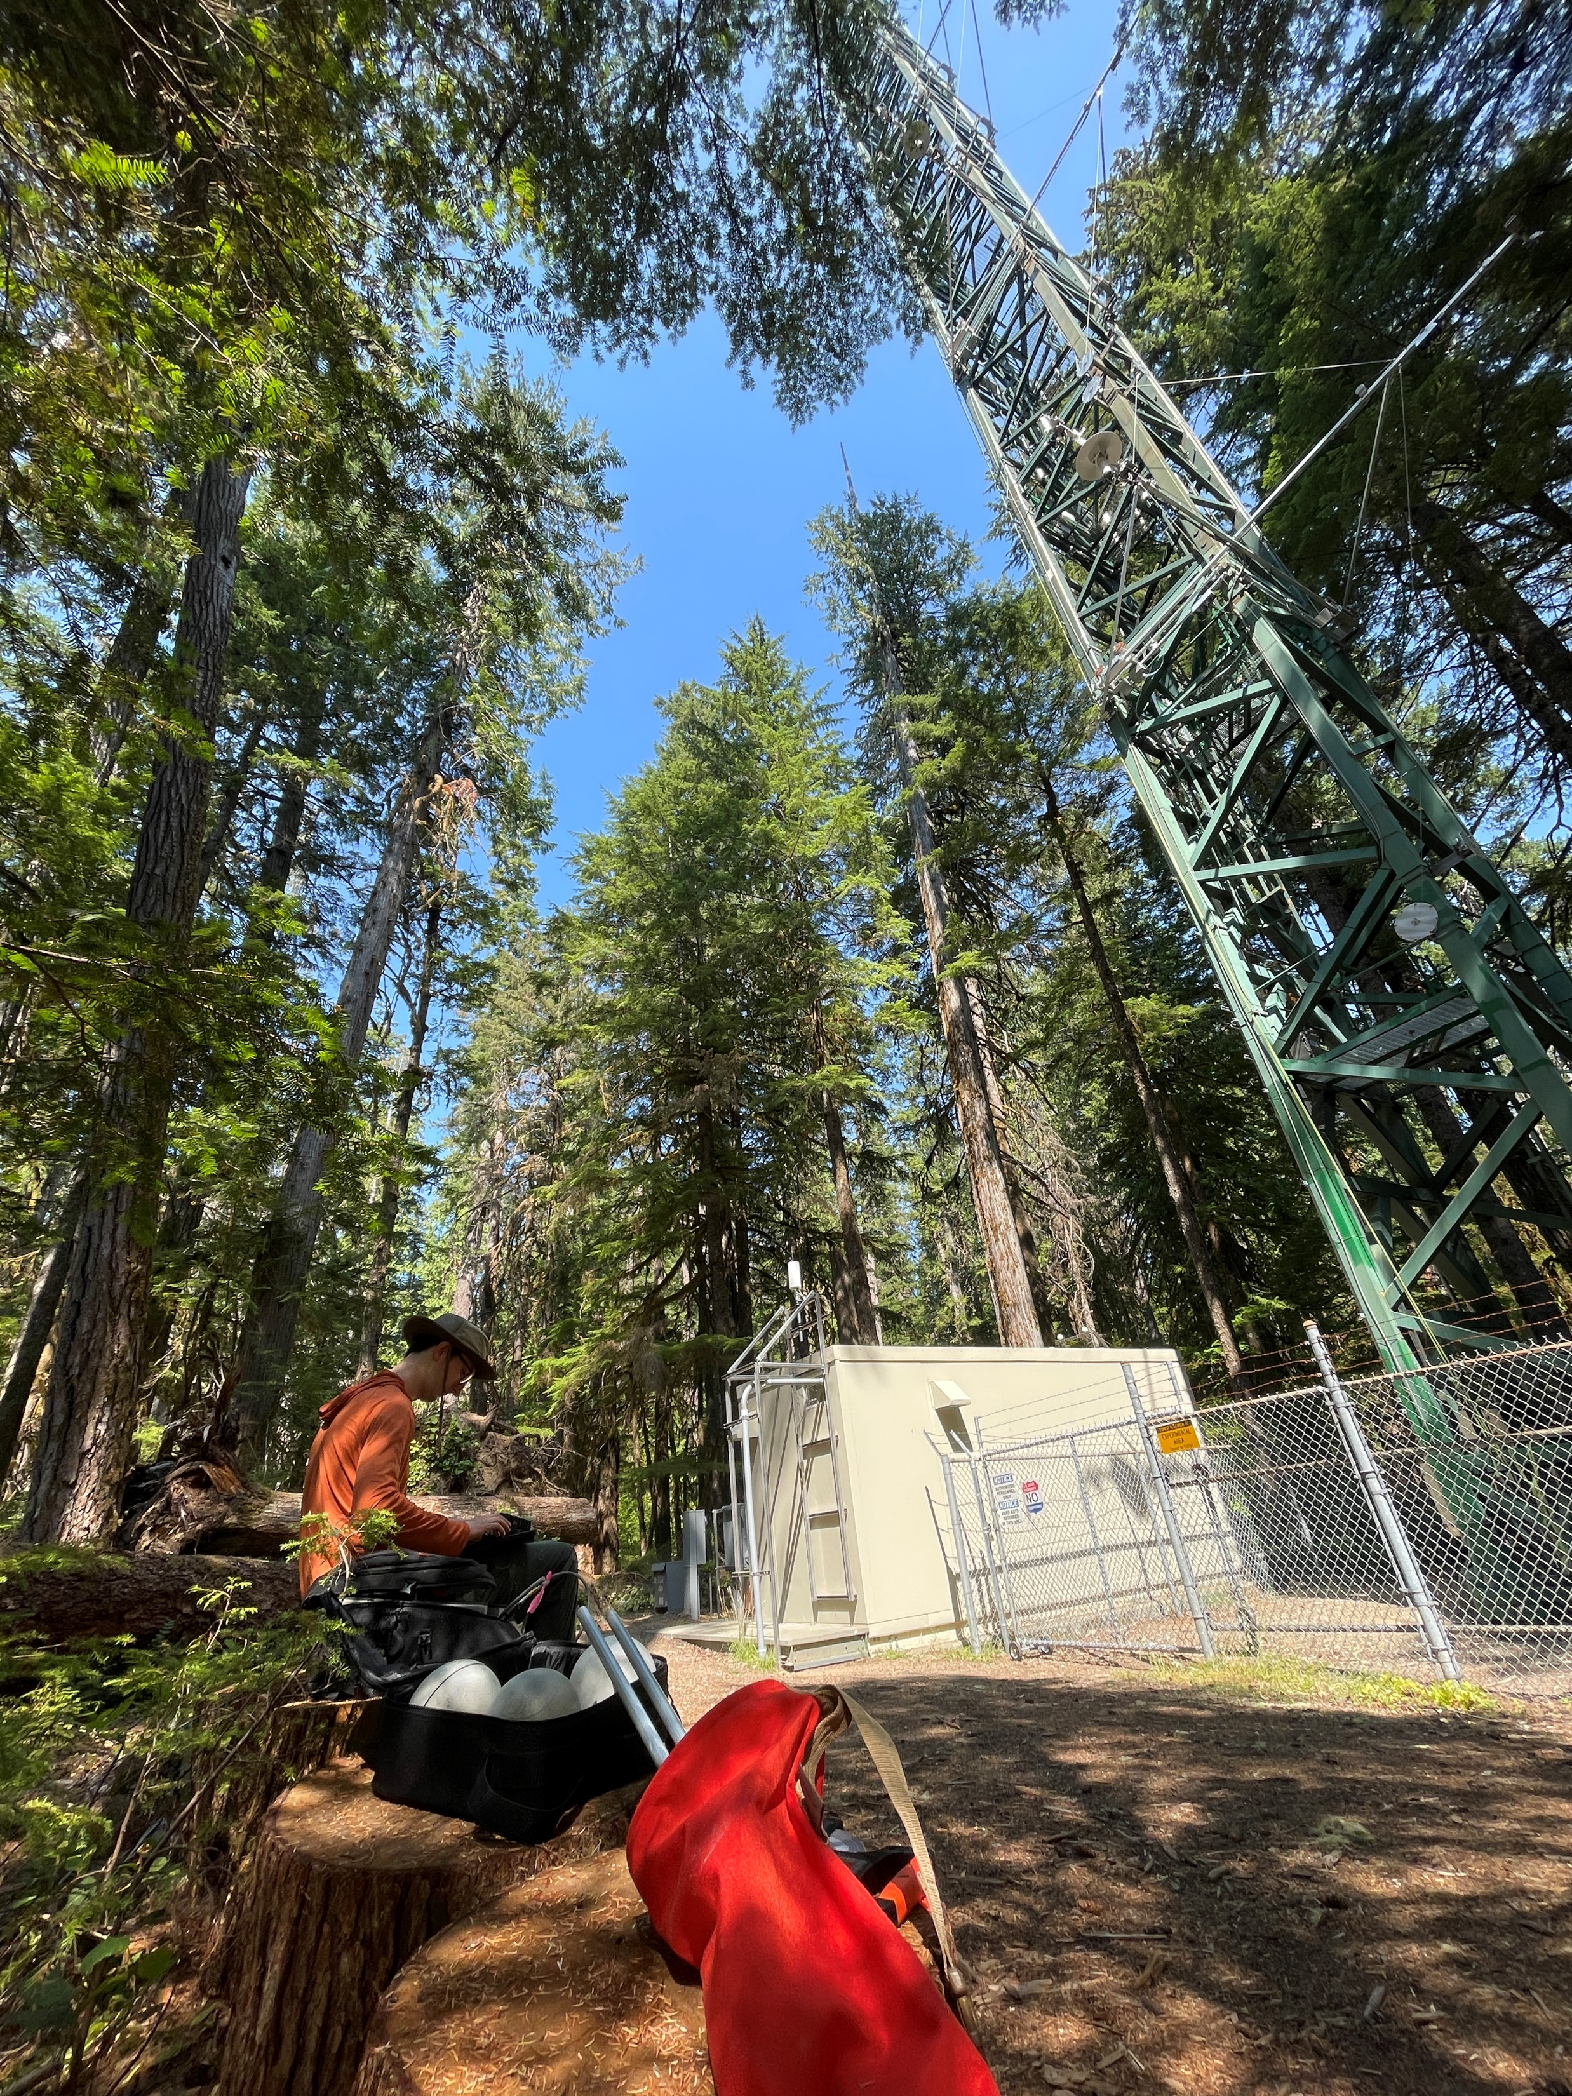
Conclusions
Evergreen needleleaf forests do not exhibit homeothermy at any canopy position
R_{n} > λE, so leaf temperature is generally driven by the environment
Evergreen needleleaf forests will not be resilient to thermal stress and may warm even faster than air
WREF

Slide 21

Acknowledgements
Funding
RSGAL
NSF
Guidance
Chris Still, OSU
Bharat Rastogi, CU
Monika Moskal, UW
Etc
ganzk@uw.edu
s-kganz.github.io
Check out our GitHub repo!

